Slide 1

Project Elixir
Investment Brief
kelpglobal.com

Slide 2
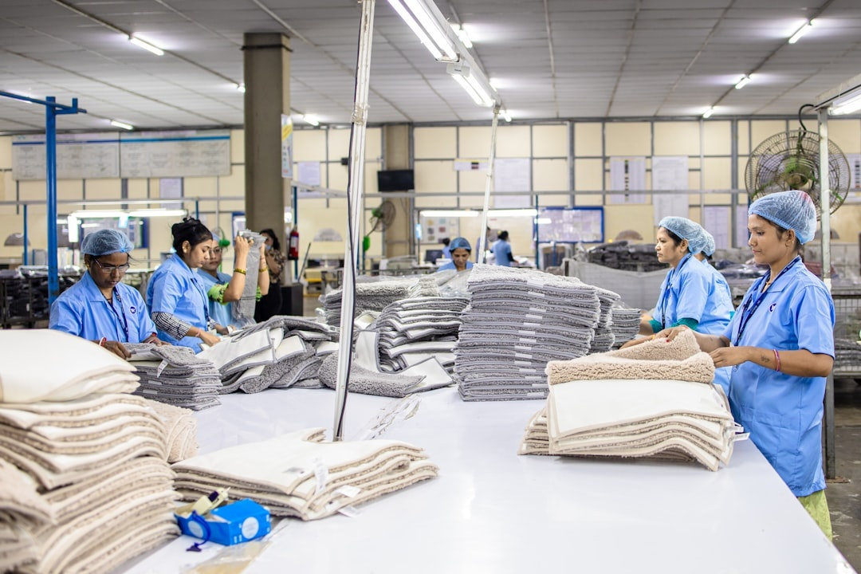
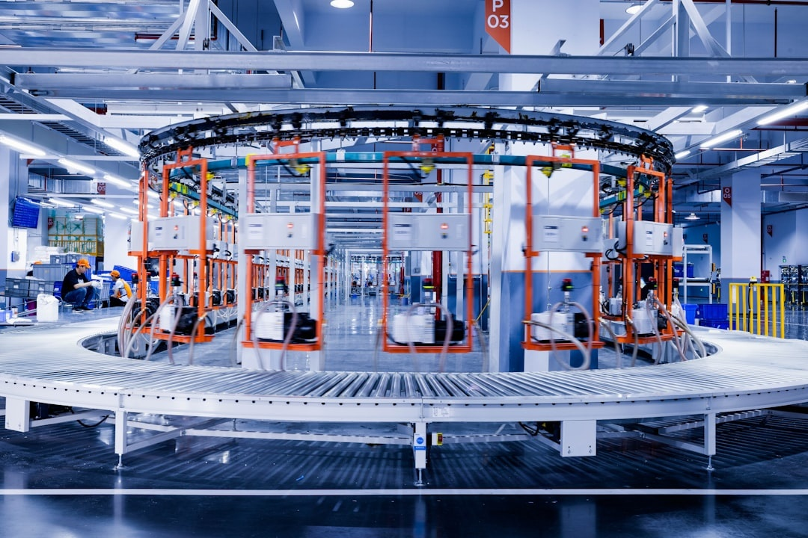
BUSINESS OVERVIEW
Business Overview:
Key Select Customers
The at a Glance
■ 3 WHO-GMP certified manufacturing facilities with high-capacity production lines
Leading Global Pharmaceutical OEMs
955
■ 955 skilled professionals with deep expertise in chemical synthesis and regulatory affairs
Employees
Top-tier Generic Drug Manufacturers
3
■ Extensive product registration portfolio across regulated and semi-regulated markets
Manufacturing Units
■ Adherence to global quality standards including US FDA, UK MHRA, and ISO 9001:2015
Major International Pharmaceutical Distributors
Global
Export Presence
Growth led through its growing product portfolio and offering solutions to diverse sectors
Leading Healthcare and Hospital Chains
Certifications
Active Pharmaceutical Ingredients (APIs)
Finished Dosage Forms
FDA
ISO
FSSAI
Specialized Therapeutic Formulations
Complex Intermediates
GMP
FSSC
Halal
Kosher
HACCP
Organic
Strictly Private & Confidential – Prepared by Kelp M&A Team

Slide 3
KEY FINANCIAL METRICS
₹ 5022.5 Cr
11.8%
9.7%
₹ 142.3 Cr
Latest Revenue
Revenue CAGR
EBITDA Margin
Latest PAT
Strictly Private & Confidential – Prepared by Kelp M&A Team

Slide 4
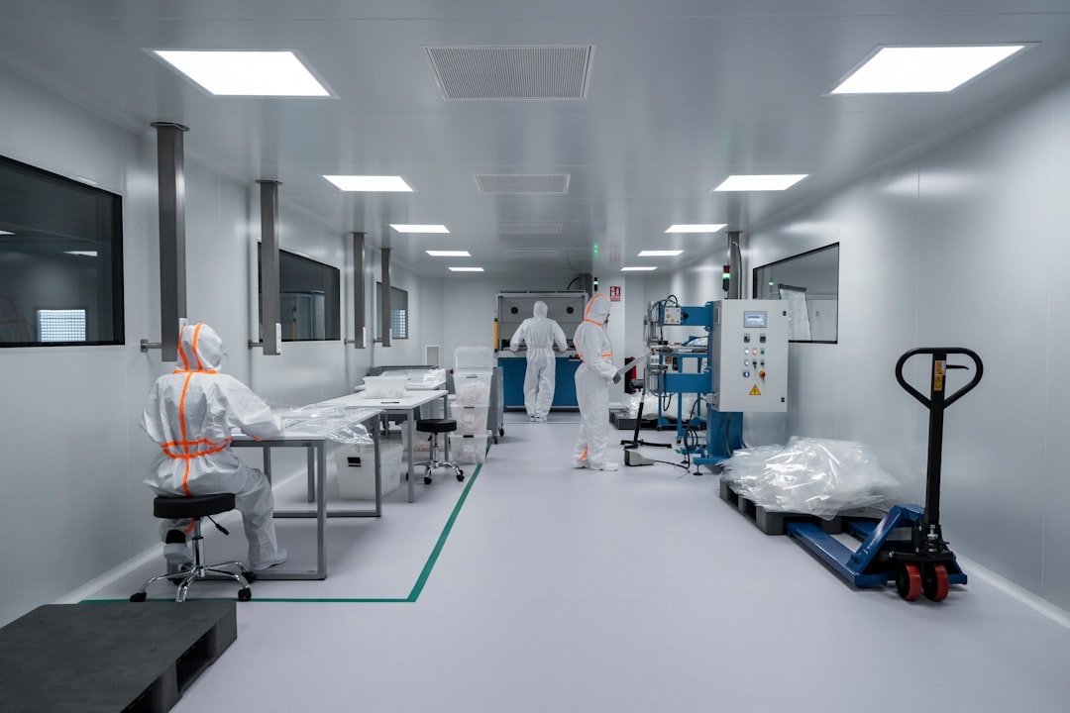
INVESTMENT HIGHLIGHTS
Capitalizing on India’s Economic Ascendance
Leveraging India's position as the world's 5th largest economy to capture a larger share of the global pharma market, where Asian firms currently hold only 10% of total market capitalization compared to 56% in the U.S.
Proven Operational Turnaround
Demonstrated strong execution by achieving a positive PAT of ₹142.3 Cr in FY24 from previous losses, signaling optimized cost structures and a successful transition to a profitable business model.
Global Sourcing & Partnership Expansion
Strategic alignment with global sourcing platforms and participation in premier forums like Pharmtech Expo 2026 to drive international partnerships and high-value export contracts in a value-expanding industry.
Strategic Entry Point for Global Players
Offers a high-scale platform for U.S. and European drugmakers to establish a localized manufacturing footprint and gain immediate access to the rapidly growing Indian pharmaceutical ecosystem.
Value-Driven Industry Tailwinds
Benefiting from the global pharmaceutical industry's shift toward value expansion and robust pricing power, ensuring sustainable margins and resilience against global volume fluctuations.
Strictly Private & Confidential – Prepared by Kelp M&A Team

Slide 5
Important Notice & Disclaimer
Strictly Private & Confidential. This presentation is prepared by Kelp Global exclusively for the intended recipient and may not be reproduced or distributed without prior written consent. This document is for informational purposes only and does not constitute an offer to sell or a solicitation of an offer to buy any securities. While all information is obtained from sources believed to be reliable, Kelp Global makes no representation or warranty regarding its accuracy or completeness.
Strictly Private & Confidential – Prepared by Kelp M&A Team

